Slide 1
Introduction to microgrids
Mark J. Gaudette P.E.
2/6/2018
Notes:
This template can be used as a starter file for presenting training materials in a group setting.
Sections
Right-click on a slide to add sections. Sections can help to organize your slides or facilitate collaboration between multiple authors.
Notes
Use the Notes section for delivery notes or to provide additional details for the audience. View these notes in Presentation View during your presentation.
Keep in mind the font size (important for accessibility, visibility, videotaping, and online production)
Coordinated colors
Pay particular attention to the graphs, charts, and text boxes.
Consider that attendees will print in black and white or grayscale. Run a test print to make sure your colors work when printed in pure black and white and grayscale.
Graphics, tables, and graphs
Keep it simple: If possible, use consistent, non-distracting styles and colors.
Label all graphs and tables.

Slide 2
Microgrid Overview
Personal Background
What is a Microgrid?
What need do they fulfill?
Types of Microgrids
How do they work?
Local Microgrids that have been done
Current Grants for Grid Scale Microgrids
Energy Efficiency opportunities?????
  After all this is a meeting on Energy Efficiency
Notes:
Give a brief overview of the presentation. Describe the major focus of the presentation and why it is important.
Introduce each of the major topics.
To provide a road map for the audience, you can repeat this Overview slide throughout the presentation, highlighting the particular topic you will discuss next.

Slide 3
Personal Background
Have a B.S. in Electromechanical Engineering from Wentworth Institute of Technology
  EIT was Passed in MA 4/2007
  P.E. Electrical Power Systems in ME and CT
Worked as a Distribution Engineer at Central Maine Power Company(Now Avangrid) for 5 Years
Currently work as a Utility Electrical Engineer for Norwich Public Utilities
My professional interests
  System Protection schemes and fault finding
  Distribution Construction Engineering
My Personal Interests
  Python Programming
  Designing Electronics for home automation (at the transistor level)
I currently live in Griswold, CT with my wife and almost 2 year old son.
Notes:
This is another option for an Overview slides using transitions.

Slide 4
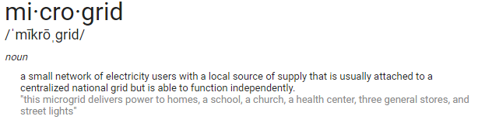
What is a Microgrid
From Google.com

Slide 5
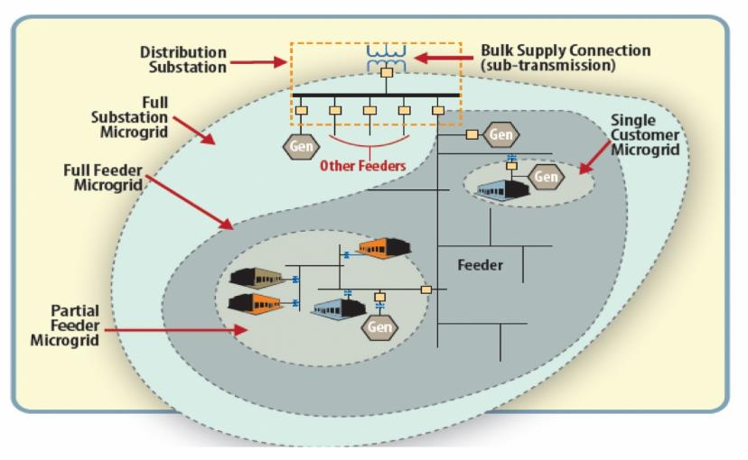
What is a Microgrid
From the DOE website

Slide 6
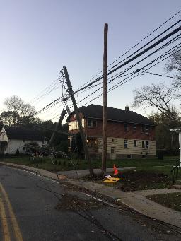
What need do they fulfill
Provide Emergency Power when the grid is down
Unlike Conventional Standby Generators they can also provide income by being a peak shaving unit with the ISO
They provide less emissions than conventional standby generation

Slide 7
Types of Microgrids
Consumer Based
Grid Based
An example of Consumer Based is a College Campus system where central
An example of Grid Based is Potsdam, NY. https://www.youtube.com/watch?v=ER6bnIuAGco

Slide 8
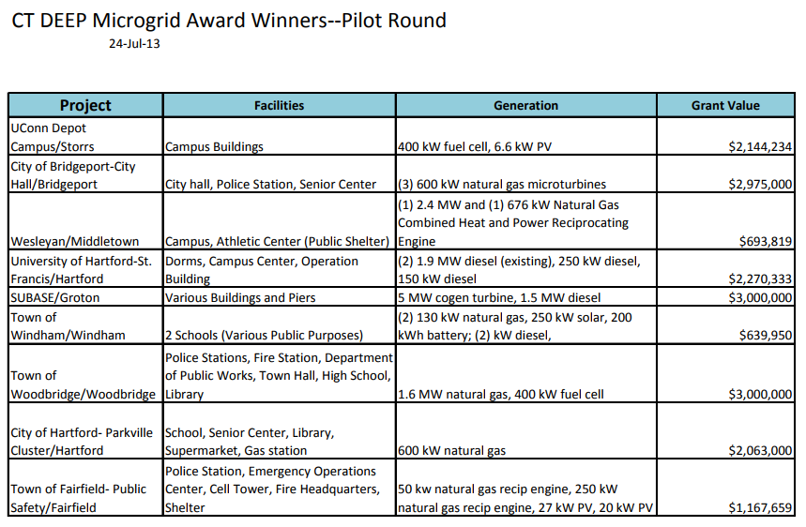
Local Microgrids

Slide 9
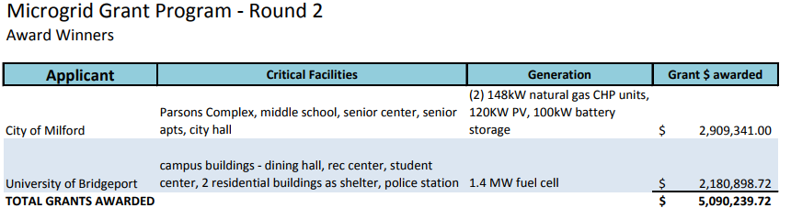
Local Microgrids
https://www.energizect.com/your-town/solutions-list/microgrid_financing

Slide 10
How do they work?
Notes:
Give a brief overview of the presentation. Describe the major focus of the presentation and why it is important.
Introduce each of the major topics.
To provide a road map for the audience, you can repeat this Overview slide throughout the presentation, highlighting the particular topic you will discuss next.

Slide 11
Differences between the Grid and a Microgrid
Generator Output
Voltage Regulation
Frequency Regulation
Heat Rate
Capital Cost
Fault Level
Reliability
Power Quality

Slide 12
Power Sources
Liquid and Gaseous Fuels (Natural Gas or Diesel)
Solar
Hydro
Other renewables
Notes:
Renewables can really only be used for fuel saving not for the main power grid due to stability.

Slide 13
Close Transition vs Open Transition
Close Transition is ideal since the end use sees no outage if the grid goes down. However, this type of system is a lot more costly.
Open Transition means that if the grid fails the microgrid will be isolated from the main grid first and then started up.
Notes:
Renewables can really only be used for fuel saving not for the main power grid due to stability. Diesels can only run so low due to wet stacking.

Slide 14
Current Grants or Special Financing
https://www.energizect.com/your-town/solutions-list/microgrid_financing
A little bit about CMEEC/NPU/Groton Utilities Attempt at securing DEEP Funding.

Slide 15
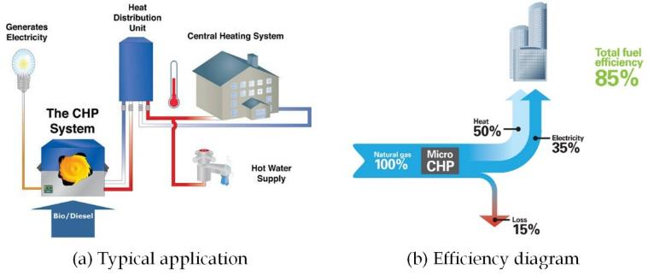
Energy Efficiency Opportunities
Todays Grid VS MICROGRID
I²R Losses
Opportunities for Combined Heat and Power (CHP)

Slide 16
Questions?

Slide 17
Thanks for having me today
Mark Gaudette P.E.
978-270-4157
GaudetteJM@me.com
Notes:
Is your presentation as crisp as possible? Consider moving extra content to the appendix.
Use appendix slides to store content that you might want to refer to during the Question slide or that may be useful for attendees to investigate deeper in the future.

