Slide 1
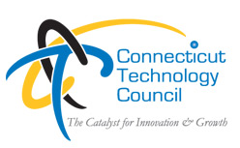
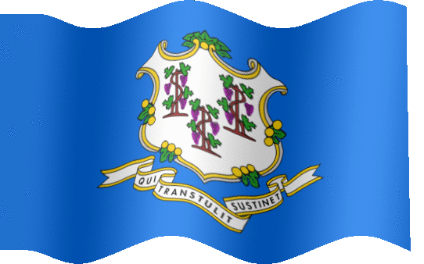
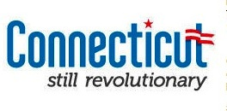
Connecticut
Change and Innovation
Matthew Nemerson
President & CEO – CTC
February 2013
2.4

Slide 2


An alliance of two organizations
Combined audience of over 15,000
people and firms in the innovation, support and tech community
17 year old State-wide trade association to support the technology community.
Promote growth & innovation
Members include largest to small firms
Speak for 2,000 tech firms
Global and national affiliations
Best practices in other states -TECNA
2011 Connecticut Competitiveness Agenda
Annual Legislative Agenda
Women of Innovation
Tech Top 40 Awards
100 Companies to Watch Awards
Monthly PowerMatch
Various forums: CEO, CIO
Peer to peer month roundtables
25 year old State-wide trade association to support the venture and risk capital community to the creation of start-ups and the availability capital.
Creates opportunities to connect ideas and capital
Members include VCs, key service providers, entrepreneurs
Crossroads Venture Fairs
Entrepreneurial bootcamps
Regional Chapter meetings & events
Development of VC funds & community
Connections to Angels and Private Equity

Slide 3
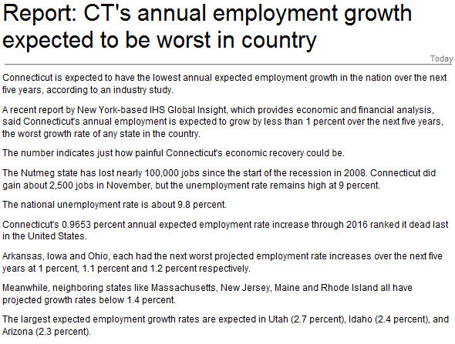
2010 – facing a serious problem

Slide 4
Trends
Tech and Business
World
Connecticut
Digitization
Big Data
Productivity
Globalization
Personalization
Value maximizing
Moral clarity
Post Industrial
Education
Weather
Energy
Alliances
Water
Black Swans
Growth
Finances
Localism
Leadership
Generational
Health Care
Housing
Values

Slide 5
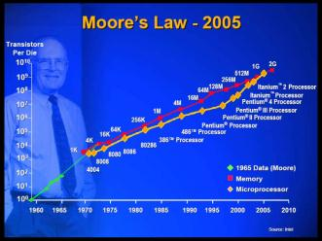
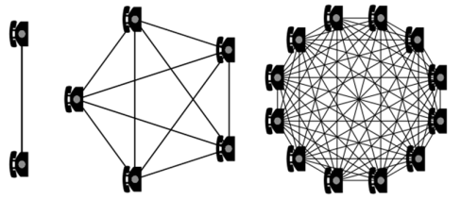
Fundamental Laws
Moore’s Law – computer speed increases T ^{n}
Metcalf’s Law – network value increase N ^{x}
Reed’s Law – Group of size n will have subgroups of 2^{n}

Slide 6
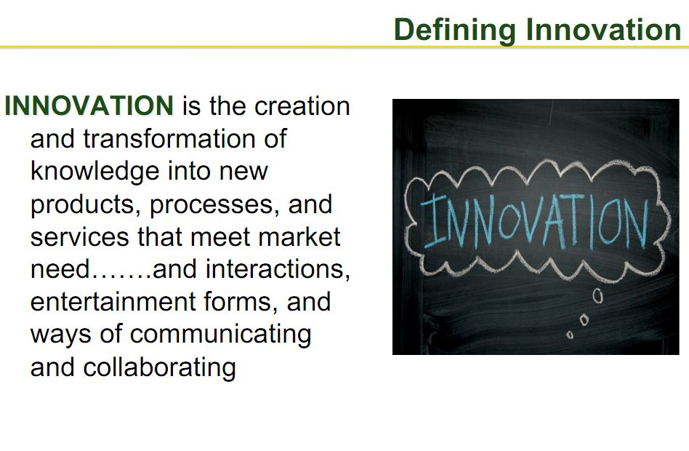

Slide 7
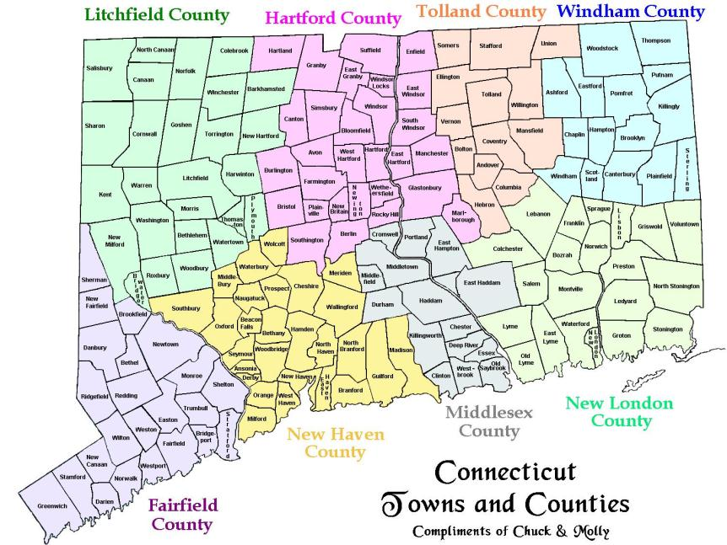

Slide 8
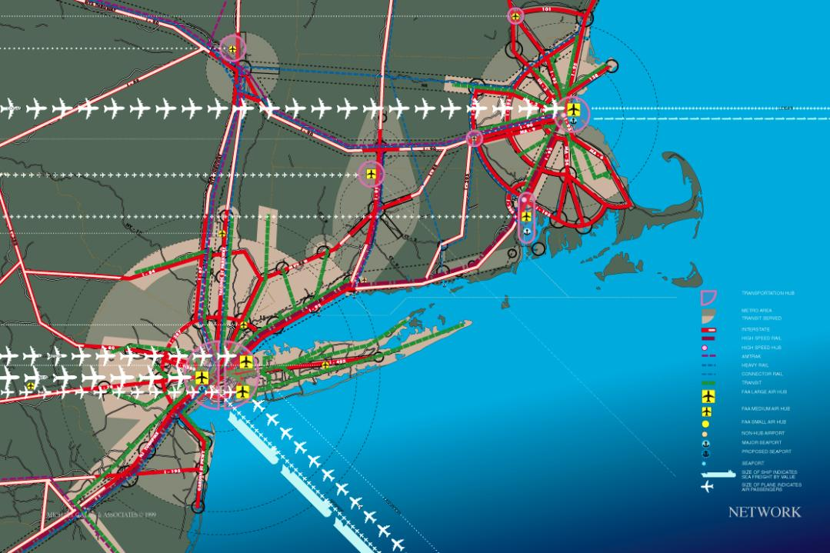
Gallis Corridor slide

Slide 9
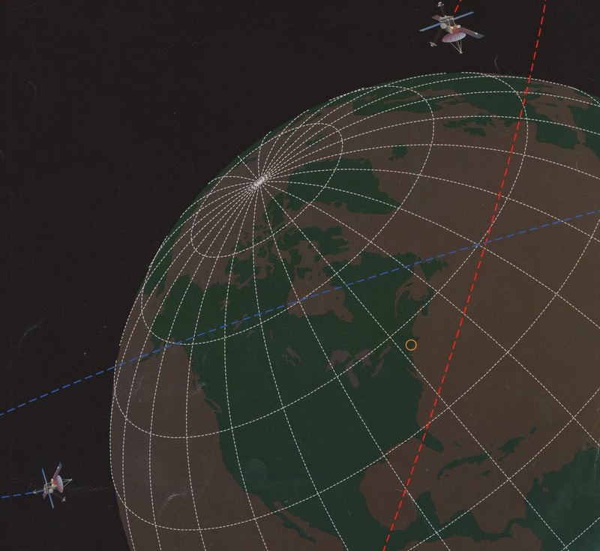

Slide 10
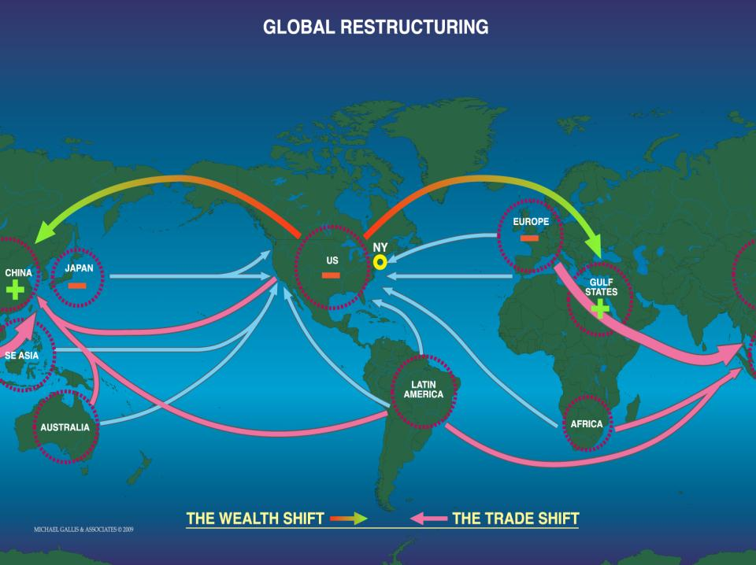
ASIA
132
118
135
NAFTA
193
191
158
EUROPE
163
177
189
Fortune 500
2000
2005
2009

Slide 11
2010 Rank Index Score
1. New York 2.34
2. Washington 2.17
3. Massachusetts 2.04
4. New Jersey 1.93
5. Oregon 1.93
6. Louisiana 1.61
7. Illinois 1.57
8. Oklahoma 1.55
9. Texas 1.54
10. New Hampshire 1.49
11. North Dakota 1.48
12. Vermont 1.44
13. California 1.44
14. Delaware 1.43
15. Idaho 1.34
16. Wyoming 1.33
17. Connecticut 1.32
18 .Kansas 1.23
19.Florida 1.21
20.Pennsylvania 1.20
The University of Nebraska-Lincoln
Bureau of Business Research © 2011

Slide 12
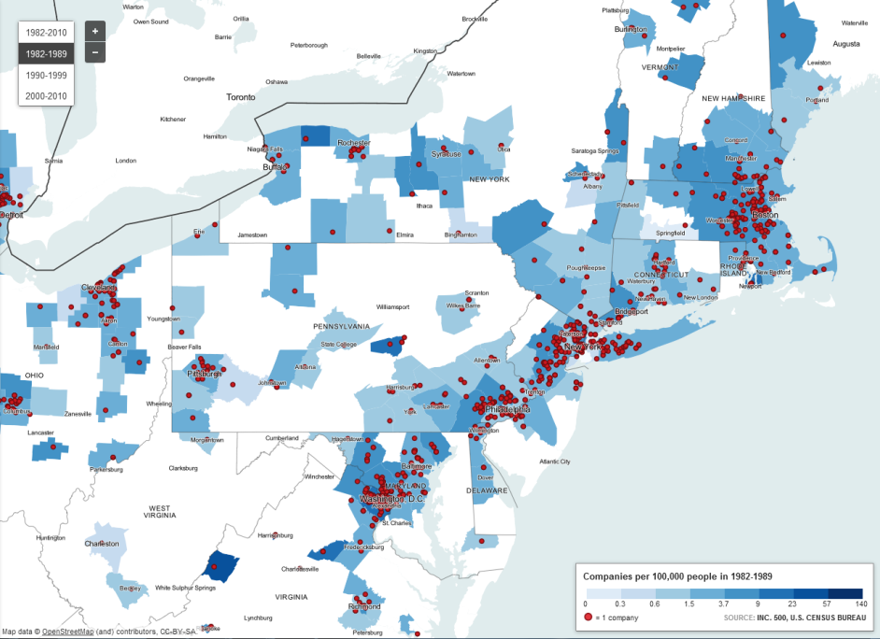

Slide 13
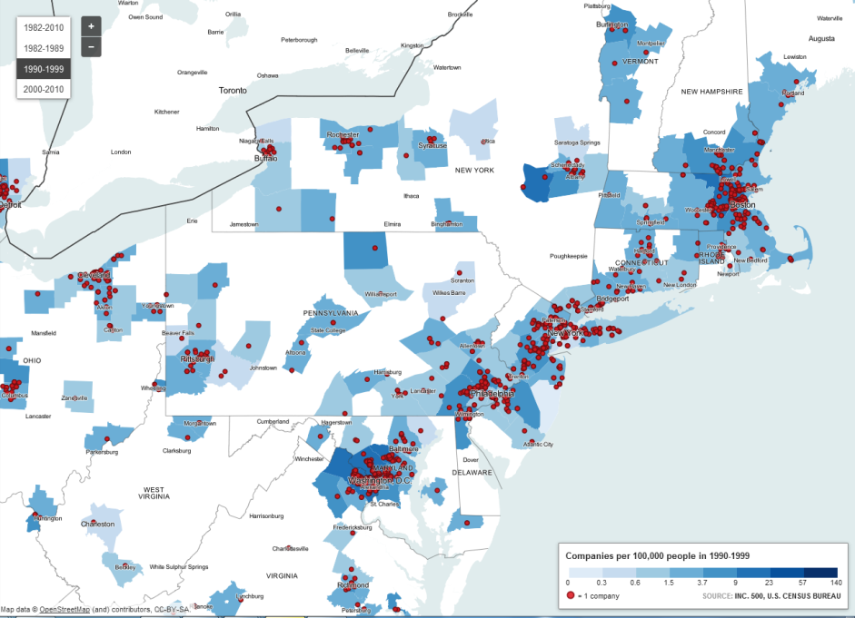

Slide 14
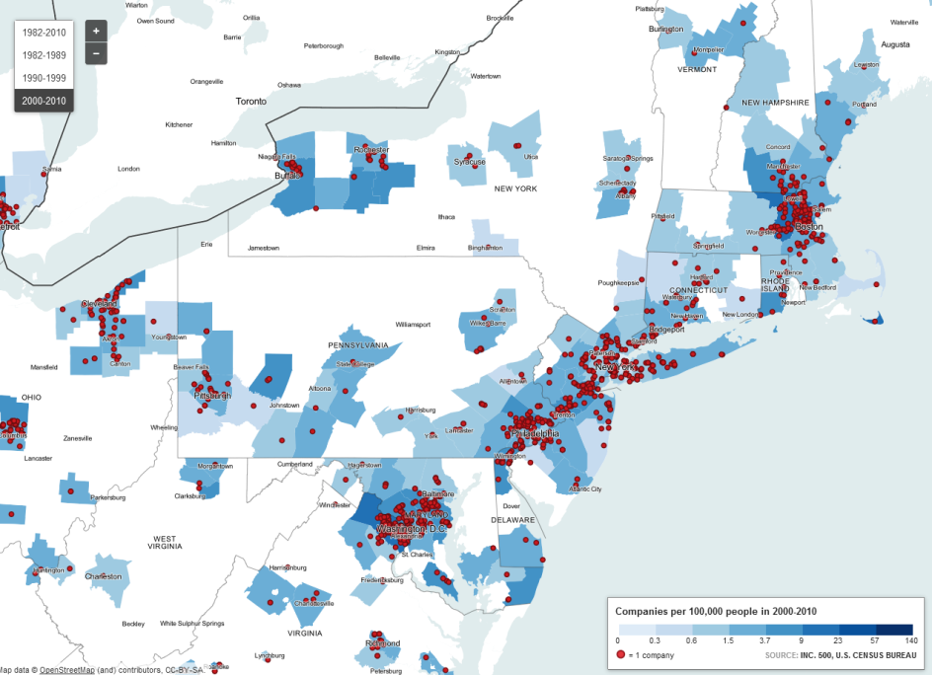

Slide 15
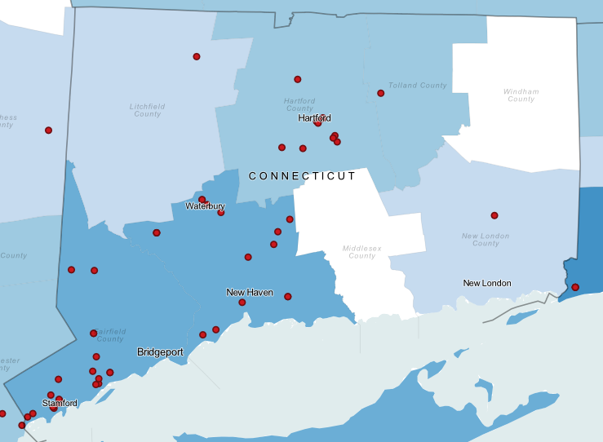

Slide 16
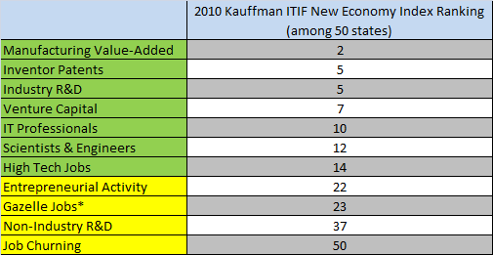
CT is failing to turn key assets into innovative, entrepreneurial growth

Slide 17
While young companies create most jobs, older ones lose them
Connecticut, 2008 | Employees | % of Jobs | CT Rank
Stage 1 | (2-9) | 30% | 34
Stage 2 | (10-99) | 33% | 44
Stage 3 | (100-499) | 14% | 23
Stage 4 | (500+) | 15% | 7
Source: YourEconomy.com. Edward Lowe Foundation.

Slide 18
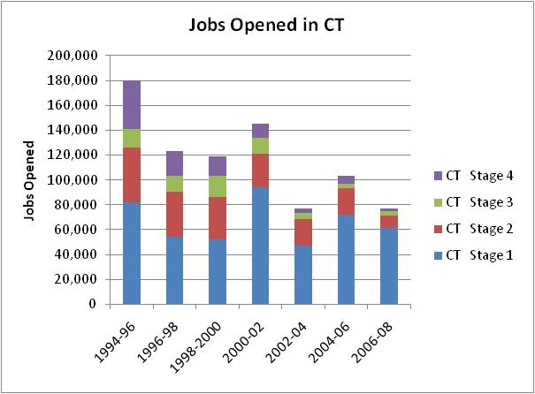
The story of job. “Net” jobs lost or gained only tells us a little bit. Here’s jobs created…
Source: YourEconomy.com. Edward Lowe Foundation.

Slide 19
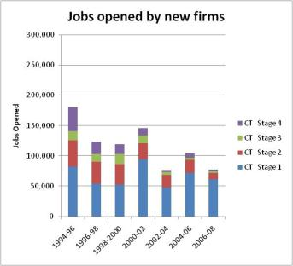
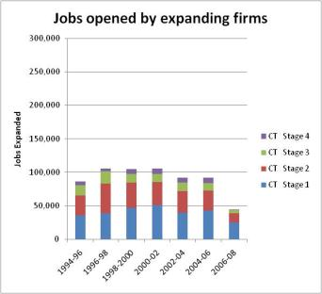
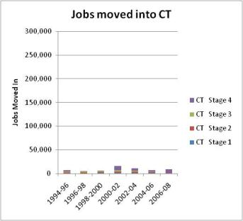
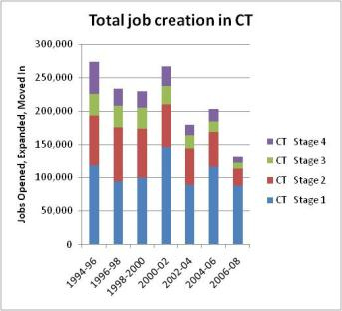
Smaller firms dominate job creation
Jobs started by new firms
+
+
=

Slide 20
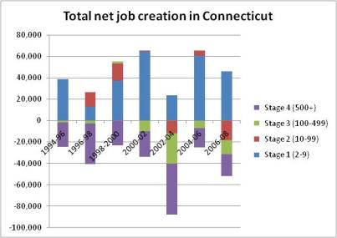
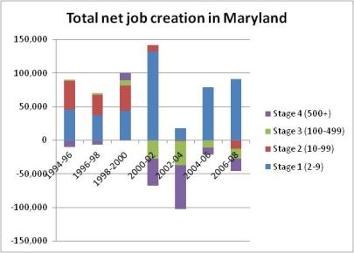
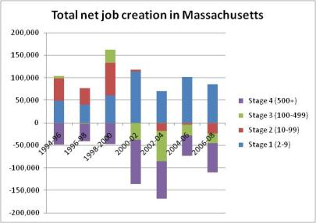
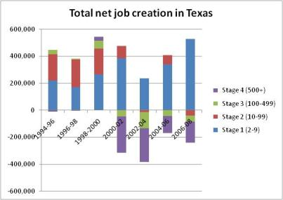
Stage 1 compensates for MD & TX for job losses. Not CT and MA
-5,000
+55,000
-20,000
+250,000

Slide 21
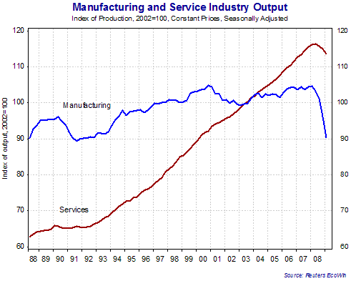

Slide 22
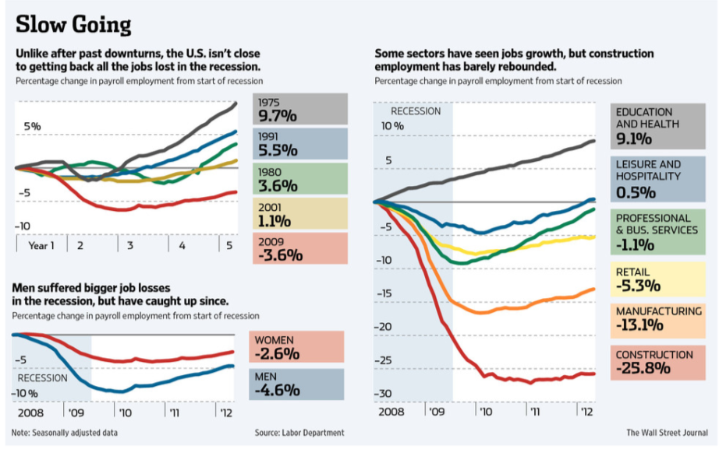

Slide 23
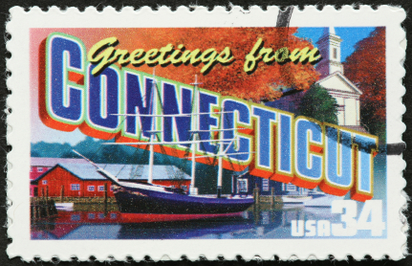
Why is Connecticut at the bottom for job and firm growth?
What is wrong?
Asked CEOs of fast growing firms
Created an agenda to help stop issues that are slowing job growth

Slide 24
What we usually hear…
Taxes and cost too high here –
  But compared to other high value added locations we are competitive
Electrical costs too high
  An issue for manufactures but not really for others, and we lead the nation in output/btu
Not enough skilled local graduates
  There is lots of talent in the greater Northeast – and some of our cities top nation for young people
  So there must be other things that are causing us to fail.

Slide 25
What CEOs of Fast growing firm said
Issue | Mentioned in Interview
State (or Governor) doesn’t know my company and does not know how to help me. Others state’s seem more on top of my needs | 72%
University Research – Hard to connect with professors, grad students and labs; tech transfer complicated. I do better with other state’s universities. | 66%
Connections & Networks – Regional innovation networks are frail or non-existent, hard for young talent to find us, hard to get to NYC or the world | 62%
Risk Capital – Seems harder to get here and investors are not as excited about my industry | 62%
Critical Mass – Not enough other entrepreneurial companies like mine. Top competitors are elsewhere. Need to be in the center of the action for future success. Will be harder to recruit top people, customers and investors. | 55%
Is it Worth the Cost? – My objective is growth, not cost-minimization: high cost worth it if the environment is world class for growth and key employees. This competitiveness is not something people think about a lot here. | 45%

Slide 26
Reasons for slower growth
High % of large firms
Too few startups
Growing firms started here (didn’t select)
Quality of life vs. weak environment
CEOs worried about ability to grow
Ecosystems must be curious, innovative and deal with unexpected needs.
Notes:
We have large % of large firms – they shrink
We start too few firms – easy to leave
Our Fast growing firms were started here
Quality of life overcomes weak environment up to a point
CEOs worried about ability to maintain growth
Eco-systems are more curious, innovative and deal with fast growth and unexpected needs.
Most fast growing CT firms were started here – none moved here. Companies likely to move if they succeed.
CEOs worried about ability to maintain growth – so getting advice, looking and finding ‘better’ locations
Quality of life overcomes weak innovation environment up to a point, but not forever
Sense that other locations are becoming more business and growth friendly while Connecticut becomes less
Most important take away: other locations are more curious, innovative and willing to deal with a culture of fast growth and unexpected needs.

Slide 27
The Connecticut Paradox
“Personally, I love it here, but it’s not a good place for my business.” - Fast growing firm CEO
CEO feelings about Connecticut
It is very good for my company here 28%
It is not good for my company to stay here 14%
It’s great for me personally, and it’s OK for my business for now 59%
Notes:
“Personally, I love it here, but it’s not a good place for my business.” - Fast growing firm CEO
So firms stay until beyond their comfort point and then often leave or find themselves underperforming. Intervention is needed earlier and start-up roots need to be explored and reconnected.

Slide 28
Innovation Asset Requirements
For an entrepreneurial ecosystem to flourish, the following assets must exist within a region:
Tangible Assets
Entrepreneurial Capacity
Business Acumen
Risk Capital
R&D Enterprise
Technology Commercialization
Human Capital
Physical Infrastructure
Industrial Base
Global Linkages
Intangible Assets
“A Buzz”
Networking Opportunities
Culture that is Supportive of Innovation
Community Mindset
Business Climate Assets
Government Policies
Quality of Life

Slide 29
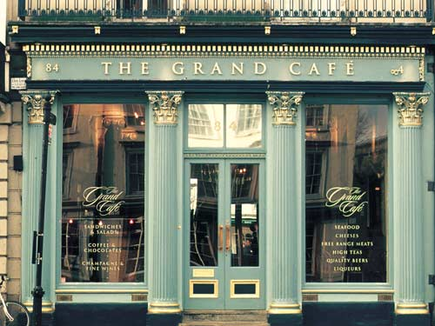
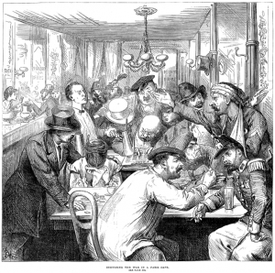
Where do ideas come from?
“Chance favors the connected mind. Interacting with people who have expertise in different areas tends to generate far more interesting ideas than being a lonely inventor,” Steven Johnson
Notes:
e sites two reasons for this. Coffee houses represented a space where people could get together and exchange thoughts. This is where ideas were formed and morphed into something more. Steven Johnson notes that an astonishing number of ideas at that time had some association with coffee houses.
Secondly, coffee also brought about a major change in habit. Prior to coffee, alcoholic beverages had been the primary drink in Europe, both for the masses and the elite. The transition from alcohol to tea and coffee, marked a transition from a depressant to a stimulant. We can imagine the collective impact of such change. Perhaps it is not an accident that renaissance coincided with the advent of tea and coffee.
Throughout history, coffee houses have often been a place of intense social interaction. In the 17th century, the Ottoman historian İbrahim Peçevi wrote about the prevailing culture in coffee houses:
"These were enlightened gentlemen who are lively and addicted to amusement. They could gather as groups of twenty or thirty in each coffee house. Some of them reading books, discussing rules of good manners, as others were playing chess or backgammon. Some brought their newest poems or discussed art."
It is easier to see the role of coffee houses in innovation if we understand how innovation works. Steven Johnson explains the innovation process using the idea of "exaptation". Exaptation is a term used by evolutionary biologists to describe a phenomenon where a trait optimized by an organism for a specific use, gets hijacked for an entirely different function. In the technology world, world wide web is a perfect example of exaptation. Tim Berners Lee proposed web as a mechanism for sharing information, but the web has been adapted for various purposes such as shopping, watching videos and sharing photos.
Most innovations happen in this manner. Arthur Koestler eloquently said in his bookThe Act of Creation - "All decisive events in the history of scientific thought can be described in terms of mental cross-fertilization between different disciplines".

Slide 30

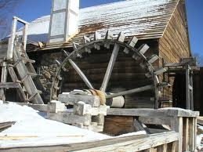
A history of Connecticut Innovation
17th century - Cheaper labor
18th c – town mercantilism
19th c – Advanced Machinery to compensate for lack of European quality labor skills
"A substitute for European skill must be sought in such an application of mechanism as to give all that regularity, accuracy and finish to the work which is there affected by a skill...."
Eli Whitney
Notes:
In The Roots of American Industrialization Meyer reexamines previous studies, provides new evidence, and presents a new explanation. He argues that agriculture and industry both grew and transformed, thus constituting mutually reinforcing processes. Eastern agriculture thrived from 1790 to 1860, and rising farm productivity permitted surplus labor to enter factories and provided swelling food supplies for growing rural and urban populations. Farms that were on poor soil and distant from markets declined, whereas other farms successfully adjusted production as rural and urban markets expanded and as Midwestern agricultural products flowed eastward after 1840. Rural and urban demand for manufactures in the East supported diverse industrial development, and prosperous rural areas and burgeoning cities supplied increasing amounts of capital for investment. Metropolitan regional hinterlands around Boston, New York, Philadelphia, and, to a lesser extent, Baltimore, experienced broadly similar transformations of agriculture and manufacturing, forming the eastern anchor of the American manufacturing belt.

Slide 31
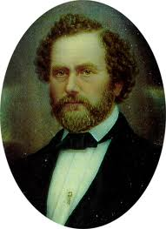
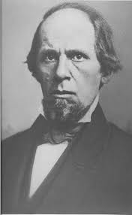
The 19th Century Invention paradigm
Cluster of inventors
Support by expert mechanics
Power: water & coal
Transportation: water & rail
Labor: immigrant and local
Capital: New York, Boston and local (using banks and “new” stock corporation)
Regulation – flirting with public control of rail and utilities (business inspired)
Public investment in health, education
Samuel Colt
Elisha Root

Slide 32
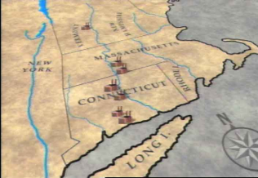
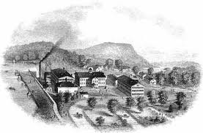
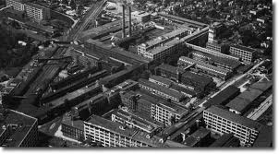
Legislated innovation networks in the 19th century
The center was the Springfield Armory, founded in 1794.
It became an incubator of technology to achieve interchangability of parts.
Why? Private contractors who held government contracts had to share their inventions
When Sam Colt was first studying to mass-produce guns, the Armory was the first place he visited.

Slide 33
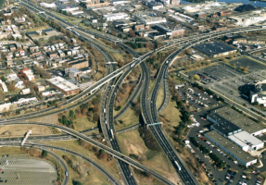

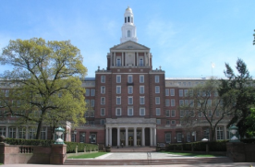
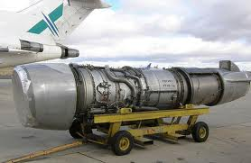
20th Century
New York Ex-urbs
No Income Taxes
Connecticut Throughway (I-95)
Successful small towns & schools
Major industries with large supply chains
  Aero-space
  Finance
  Insurance
  Pharma

Slide 34
What we need to grow jobs
Strong networks – where people know each other through out the region
Contented CEOs - who recommend the state to their best friends
Venture investors - who move their best firms to Connecticut and take higher risks on our start-ups
Agencies, organizations and institutions that seek out each other (with incentives perhaps) to collaborate and create partnerships

Slide 35
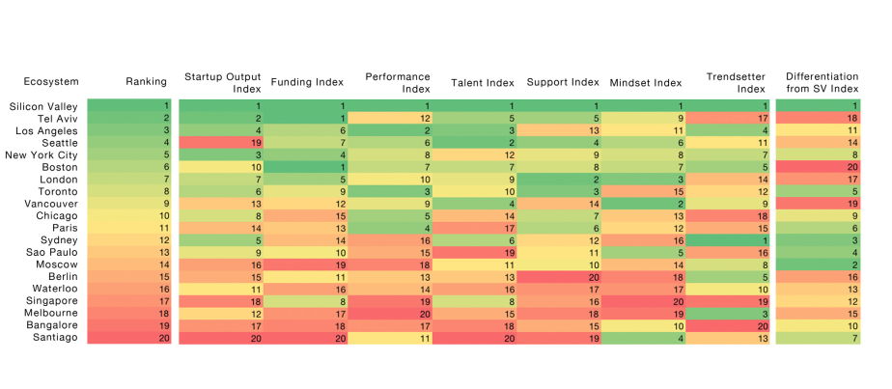
The world’s leading innovation communities

Slide 36
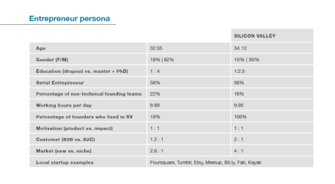
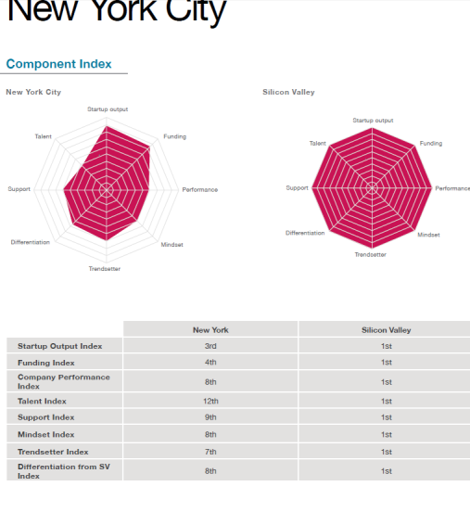
New York City compared to SV

Slide 37
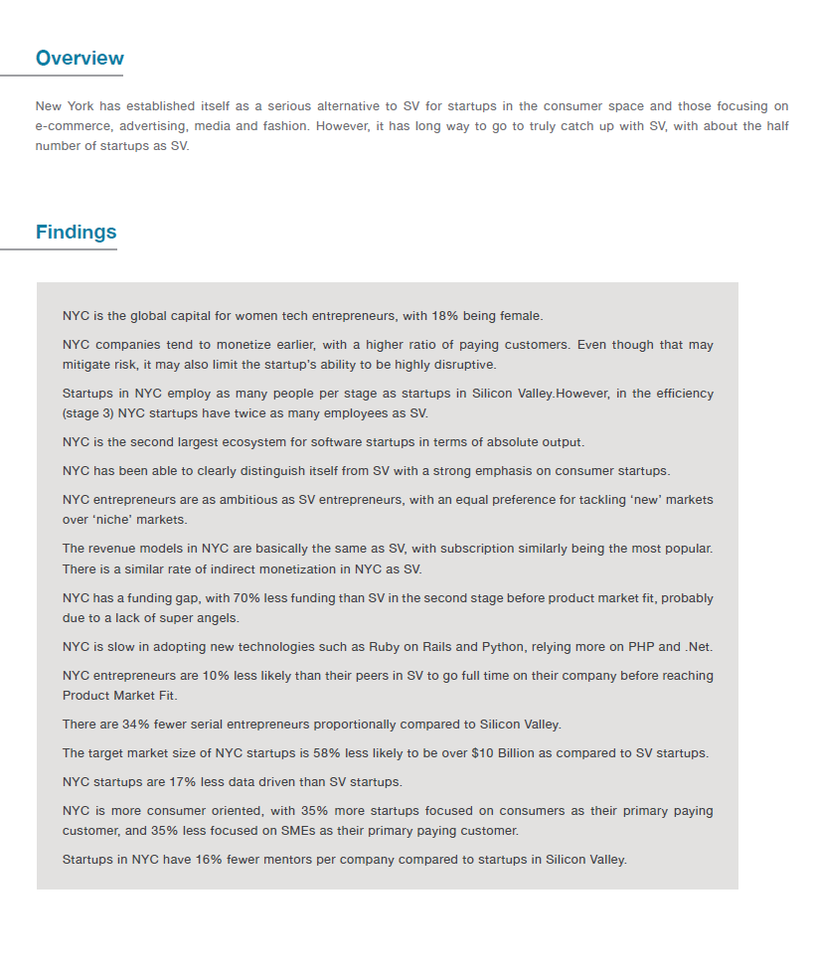
Studying other ecosystems

Slide 38

The network effect
Ample specialized skilled labor
Specialized providers + access to venture capital
Ideas, people and demand builds eco systems
Notes:
Thick labor markets with jobs for specialized skilled labor
Specialized providers to support enterprises at every stage (+ access to venture capital)
Ideas, people and supply chains creating an eco systems of successful start ups.

Slide 39
Where Do Good Ideas Come From: The Natural History of Innovation, Steve Johnson 2010
If there is a single maxim that runs through this book’s arguments, it is that we are often better served by connecting ideas than we are by protecting them…environments that build walls around good ideas tend to be less innovative in the long run than more open-ended environments. [Ideas] want to complete each other as much as they want to compete.

Slide 40
An innovation virtuous cycle
2.
Technology & Ideas
3. Risk Capital
5. Gov’t Incentives
6. Networks, Entrepreneurs & Human Cap.
7.
Global Connections and Branding
8. Transportation & Broadband
1. Policy and culture
4. Acceleration & Facilities
Jobs +
Growth

Slide 41
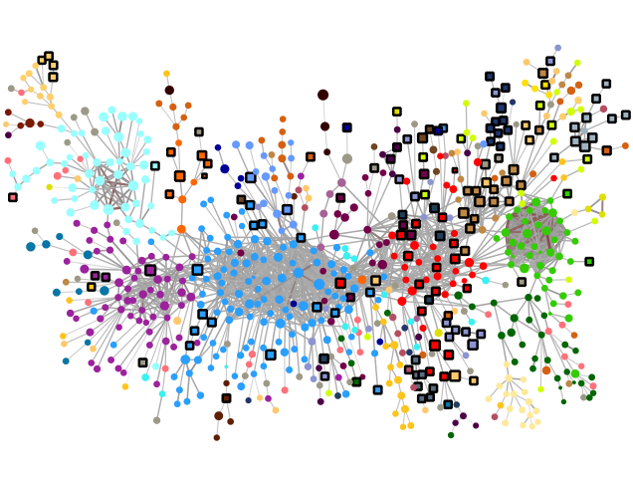

Slide 42
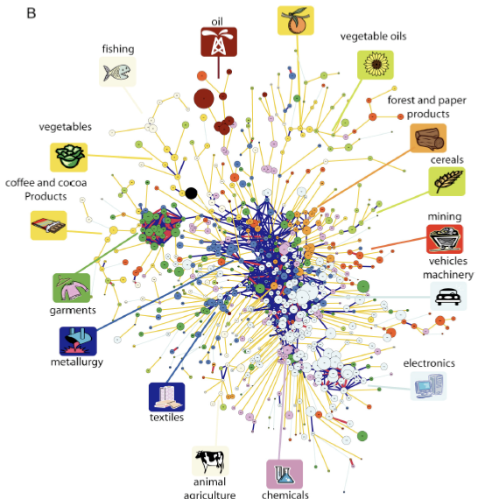
Diversity
Not
Magnitude
-Hildago

Slide 43
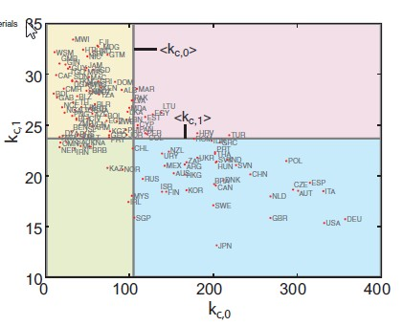
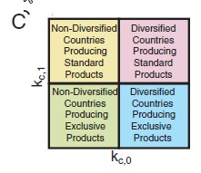

Slide 44
The Innovation Job Growth Eco-system
Venture
Later state
Jobs >
Growth
New jobs come from a deliberate process that requires many parts of a puzzle to contribute and be better than other locations at each step…
Early Stage
Seed
Technology
Transfer
Angel
Investors
Corporate
Spin Outs
Incubators
SBIR
Innovation
Accelerators
University
R&D
Validation
Skilled
Workers
Students
Networks
Associations
Mentors
Grants
Entrepreneurs
Government
Incentives
Infrastructure – Global connections
Image – Global perceptions
Notes:
We want to give you input into each of these key areas in the continuum. We have brought people from all parts of the Connecticut economy to review these issues with you.

Slide 45
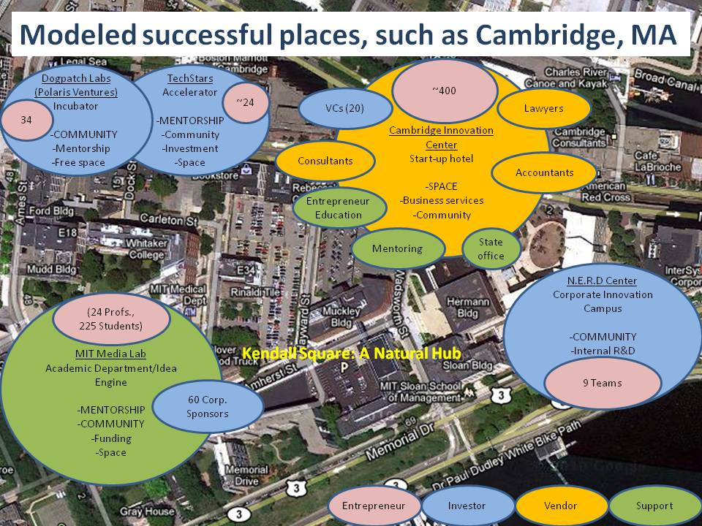

Slide 46
Innovation Ecosystem effort
Goal 1 – Fostering high potential Start-Ups
Business plan competitions
Accelerators (e.g., TechStars)
Virtual Incubators
Building Based Incubators
Funding (Grants, stipends, Pre-Seed investments, Angel connections, etc.)
Retention Efforts for growing firms
Sponsored research programs for idea and product development between companies and in-state schools
Proof of concept Center with labs--Gov’t as market maker
IP Factory and corporate networks
Student Teams and Interns Programs
Mentors Network, recruitment, training and matching
Entrepreneurs-In-Residence
“Rent a CxO” and turn-key management capacity for qualifying early stage concepts and firms
Serial Entrepreneur Fellows – Global Attraction Program
Professional Services matching and pro bono bank
Place-making and infrastructure such as i-TOD efforts to build a critical mass and a competitive set of locations
Branding and image coordination
Key labor matching and procurement programs
Technology training programs (i.e. CCSU, CC)
State, regional and hub based networking programs
Goal 2 – Assisting Stage 2 firms
New Technology, customer needs and marketing analysis
Connections with larger firms & new supply chains
Proof of concept contracts with state agencies
Grants and debt availability
Regulatory relief and help
Young talent, Job Training and matching
Build a retention strategy and mechanism
Opening up universities to collaboration
Sponsored research programs for idea and product development between companies and in-state schools
Proof of concept Center with labs--Gov’t as market maker
IP Factory and corporate networks
Student Teams and Interns Programs
Mentors Network, recruitment, training and matching
Entrepreneurs-In-Residence
“Rent a CxO” and turn-key management capacity for qualifying early stage concepts and firms
Serial Entrepreneur Fellows – Global Attraction Program
Professional Services matching and pro bono bank
Place-making and infrastructure such as i-TOD efforts to build a critical mass and a competitive set of locations
Branding and image coordination
Key labor matching and procurement programs
Technology training programs (i.e. CCSU, CC)
State, regional and hub based networking programs
Programs were selected and then prioritized by a process of expert surveys…

Slide 47
Group ranked the programs on key attributes
Managed at Hub Level
Place Making
Networking Programs
Rent-A-CxO
Entrepreneurs
in Residence
Young Talent,
Training,
Matching
Sponsored
Research Programs
Building
Incubators
Private Funding
Public Funding
Serial
Entrepreneur
Fellows
University/
Industry
Collaboration
Proof of
Concept Ctr.
Student Teams
& Interns
Accelerators
Virtual
Incubators
Connect-ions
to Large Firms
Retention
Strategy
(Stage 2)
Mentors Network
Tech,
Customer,
Mkt. Analysis
Prof. Services Matching
IP Factory
Key Labor
Matching
B-Plan
Competitions
Grants & Debt
Retention Efforts
(Startups)
STEM Programs
Reg. Relief
& Help
Creating Markets
Branding
Funding
Managed at State Level
Notes:
Funding
Retention Efforts
Accelerators
Business plan competitions
Incubators
Entrepreneurs in Residence
Mentor networks
Opening universities to collaboration
Skilled workers, key talent
Grants & debt
Retention
Regulatory Relief
Connections to larger firms
Market intelligence & assessments

Slide 48
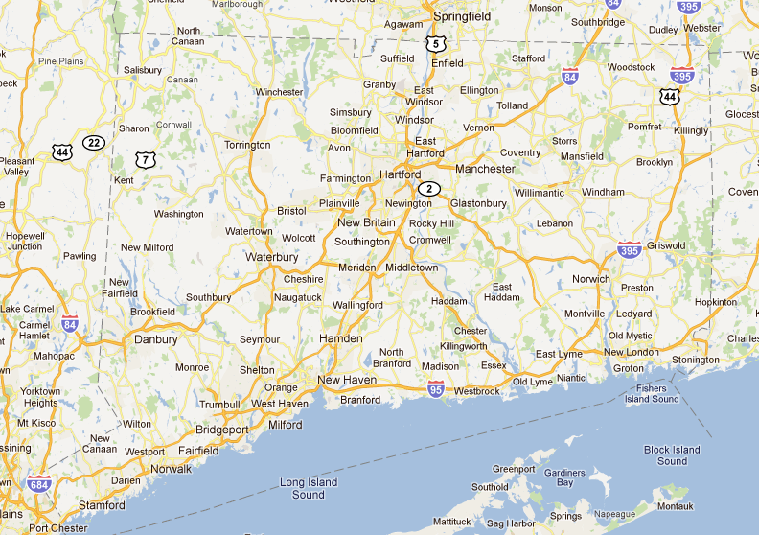
System Manager
Greater Hartford
Storrs/
New London
Fairfield County
Greater New Haven

Slide 49
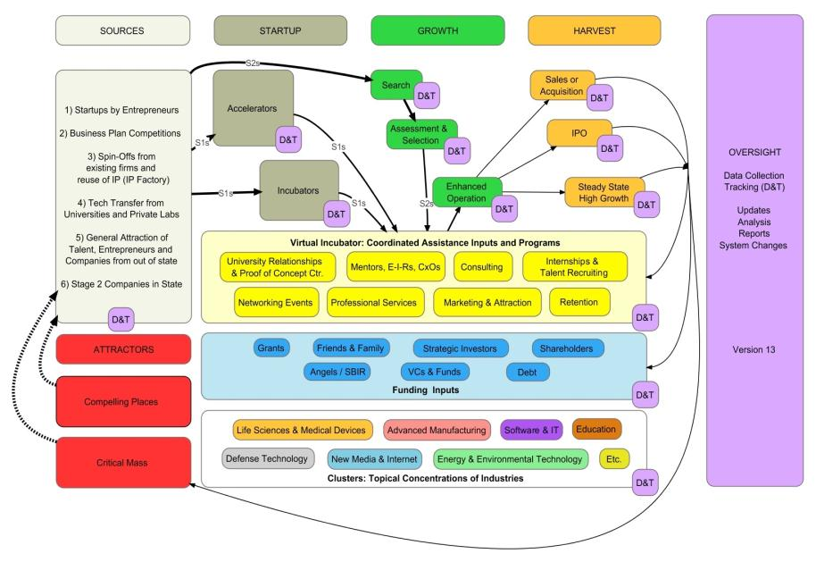
A state innovation model blueprint

Slide 50
Set goals to measure a performance
Success - actual growth and jobs
  Goal 1 – 50 high potential startups each year
  Goal 2 – 75 “stage 2” firms assisted each year
Change culture
Agility and Culture of experimentation and collaboration

Slide 51

Ecosystem is a go!

Slide 52

Lots of areas constraining entrepreneurial success
Funding Opportunities and Alternatives
Cost and Complexity
Business Plan Development
Building a team
?
Proof of Technology Readiness
Setting up Infrastructure
GAPS TO RECOGNIZING FUNDING SUCCESS
Notes:
Disorganized ecosystem of regional efforts and assets
CTO for mentorship and capital-business plan development, GLP, Catalyst, MIT Clean Energy Prize, Grants, Loans, SBIR, Competitions all of which provide varying degrees of mentorship, executive education programs, and importantly funding.
These programs help establish good foundations for companies to succeed but they tend to be periodic.
ACTION for incubators, an excellent resource that can also serve to help entrepreneur identify and fill some of their gaps in a very cost effective way.
There are a large number of test beds, often housed in the regions universities, that contain the infrastructure an entrepreneur needs to Many test beds and organizations helping emerging companies validate technology

Slide 53
Major Program Goals
Enable Collaborations
Encourage Collaborations
Improve communications and availability of information
Develop sustainable funding model for program scale
Demonstrate Cleantech Innovations NE model is sound
Create more companies and jobs for less capital

Slide 54
What does CINE do?
Provide service awards
Develop and support a robust regional network
  State Program and ACTION Liaisons
  CleanzoNE
  Mentors
Enables introductions
  Showcases/events
  CleanzoNE (future)
Cleantech Innovations NE
Service Awards
Robust Regional Networks
Enable Introductions

Slide 55
CINE Mentor Service
Current Services
Services in Q2 2013
Awardees
Qualified Applicants
Non-Qualified Applicants
Pool of Cleantech Projects & Startups
$ EIR Services $
Mentorship

Slide 56





CleanzoNE Vision
Test and Development Centers
Incubators
EIRs & Mentors
Grant/Award Opportunities and competitions
Connecting New England’s Cleantech Innovation Community
Innovator
Prototyping Services
Venture Investors
University Research
Vision:
A sustainable model where cleantech entrepreneurs can easily identify, connect and collaborate with a robust network of individuals and assets across the region working together, sometimes in pursuit of funding opportunities, to create new companies with optimal capital investment.

Slide 57
















Landscape Visibility
Start up Resources
People
Notes:
Is inventory
Place to find each other
Know about funding opportunities
Know about regional events
Enhance to include proactive introductions, elaborate mentor networks,

Slide 58
Upbeat thoughts to close on…
Environment favors Connecticut
  Water, warming, regulations
Density can go up
  Our cities are small and have capacity
Intra-Regional transportation
  Metro-North and Amtrak can expand
Housing stock is strong and well built (if old)
Near population centers of youth & talent (NYC, Boston and Washington)
But…Need to focus on growth and changing population

Slide 59


Being competitive is just that… you need to win

Slide 60
Emerging Markets 2013
Decision Engines – Discovery fueling invention and purchases
Collaborative Commerce – Community sharing, bartering, etc.
Customization – Uber personalization
True Mobility – Leaving the PC behind
Creativity – Inspiration from the Everyman
Urban Farming – Local, local, local
Game-ification – Revolutionizing customer engagement
Design – Pretty goods for the masses
Extreme Fitness – Boot camps o beat workout boredom
Jobs – Rescuing the unemployed
The One to Watch: Unmarried's – Catering to Singles

Slide 61
Thanks for your time!

